Slide 1
Who We Are
Nonpartisan, nonprofit, grassroots organization advocating for voters’ role in democracy
Began over 100 years working for some women’s right to vote and since then advocated for expanding voting rights and access
Redistricting Goal: ”Support redistricting … that promote fair and effective representation at all levels of government with maximum opportunity for public participation”
Democracy only works when we the people are in the know and engaged

Slide 2
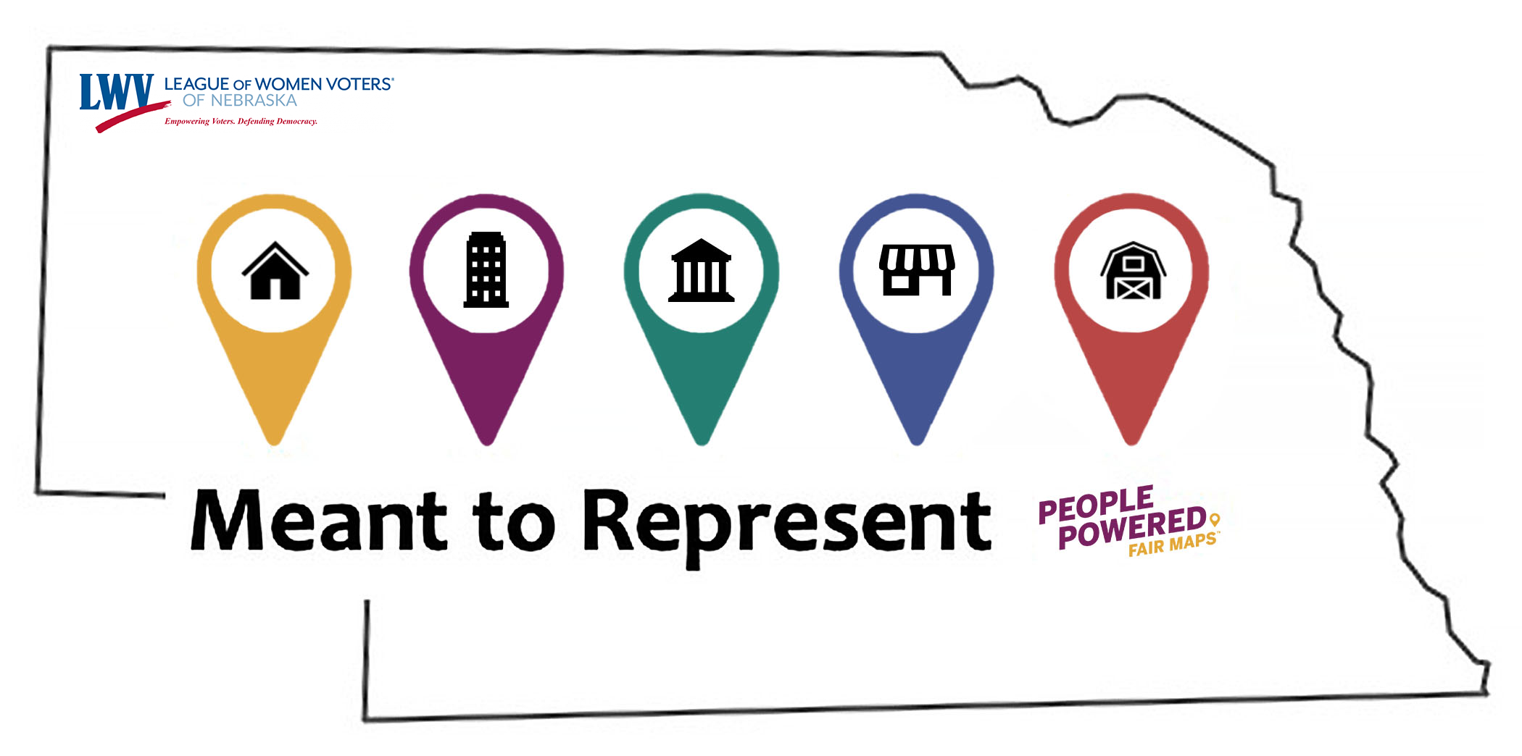
Redistricting:
Putting Your Vote on the Map

Slide 3
Mapping in Nebraska
Maps drawn by legislative research office
9 State Senators (Redistricting Committee) review/edit maps
Initial Metric Data Available
Legislative Research Office drafts Maps using GIS
Redistricting Committee Reviews and Adjusts Maps
Public Hearings on Proposed Maps
Legislature Approves Map Legislation
Governor Signs or Vetoes Map Legislation
We the people are part of the process

Slide 4
League Actions
Publicity
Informational Flyer
Brochure
Posters
Action Sheet
Videos
Meant to Represent: putting your vote on the Map
Meant to Represent: Districtr Overview
LWVGO Dine & Discuss
GOTV Game Show
PowerPoints and Scripts
M2R: Putting Your Vote on the Map – English and Spanish
Redistricting Highlights – English and Spanish
Whose Line Game Show

Slide 5
What’s Next? Take Action!
Contact policy makers
Call, write letters, email, etc.
Provide input online
Attend events
Meant to Represent Workshops
Day of Action Sept 18
Public Hearings
Join the LWVNE
https://lwvnebraska.org/join/
#FairMaps
Follow Advocacy Groups
Common Cause
The Redistricting Network
Princeton Gerrymandering Project
Ballotpedia

Slide 6
What you can do to protect your vote
Talk to friends and family
Use the internet and social media
Contact policy makers
Attend public hearings (Mid Sept. Date TBD)
Join Day of Action (Sept. 18)
You voice is important and a necessary part of our democracy

